Slide 1
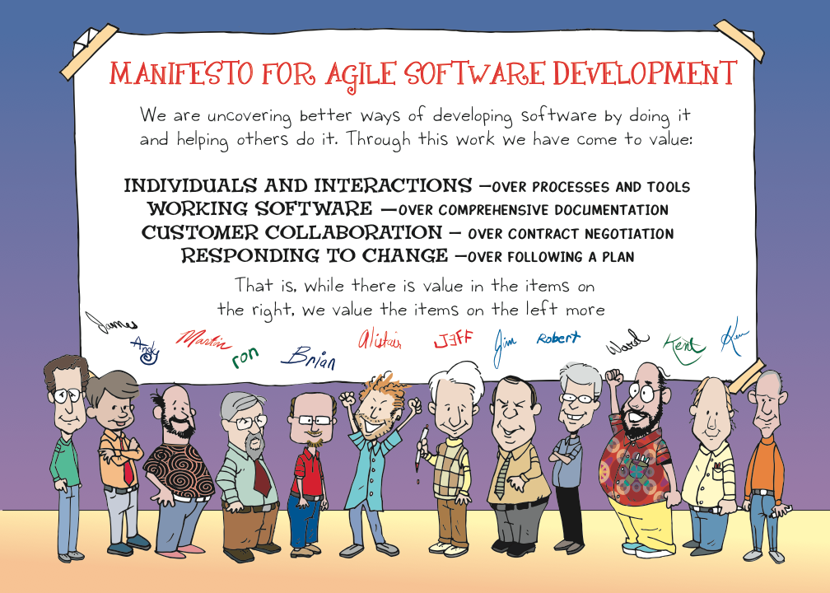
Plan/Manage
LEGO
Dev
Fun
Core
Origins
Intro
Agenda
Notes:
The result of the thinking and activities of folks like Ken Schwaber, Kent Beck, Ward Cunningham, Martin Fowler, Alistair Cockburn, and others was a document called A Manifesto for Agile Software Development.
A group of these folks – the thinkers and doers and experimenters – got together on February 11-13, 2001, at The Lodge at Snowbird ski resort in the Wasatch mountains of Utah, to talk, ski, relax, and try to find common ground - and of course, to eat. What emerged was the Agile -Software Development- Manifesto. Representatives from Extreme Programming, SCRUM, DSDM, Adaptive Software Development, Crystal, Feature-Driven Development, Pragmatic Programming, and others sympathetic to the need for an alternative to documentation driven, heavyweight software development processes convened.

